Slide 1
Solar System Simulator
Casper – Lead Programmer
Stefan – UX VFX
Stanley – Lead Artist
Thimo – UX UI
Daniël – Programmer

Slide 2
Inhoud
Art
U.X.
Progress
Demo

Slide 3
Art
?

Slide 4
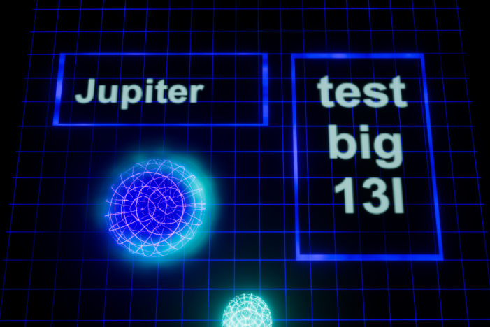
u.x.

Slide 5
progress
Basic parts working
Planning
To do:
Implementation
Upgrades
Bug fixes

